Slide 1

Python: The beginning of the end
Day-1: Introduction to Python Programming Language
Notes:
0
0

Slide 2
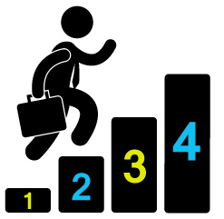
Python Training Path
Day-1: Basics of Python
Data Structure & Data Type
Project: Automating email task for marketers
Day-2: Functions, Loops and Conditional Statements
Python Syntax of each task
Project: Improving email automation task
Day-3: Numpy and Pandas
Numpy and pandas data structure
Project: Retail store data analysis
Day-4: Hands-On Projects
Project-1: Wikipedia Web Scrapping
Project-2: Fraud Pattern Identification in BFS
Project-3: Chatbot Creation

Slide 3
Day-1: Basics of Python
Data Structure & Data Type
Project: Automating email task for marketers
> Go to Python Notebook

Slide 4
Python – Data Types Summary
str: String or a type to represent text, you can use single or double quotes to build a string, e.g. ‘data science’, “data science” etc.
int: Integer or a number without fractional part, e.g. 4, 7 etc.
float: Floating point or a number that has both an integer and fractional part, separated by a point, e.g. 1.1, 3.2 etc.
bool: Boolean or a type to represent logical value and it can only be True or False (first letter is capital)
Examples:-
A = “3.14”
B = ‘5645’
C = 32
D = 23.12
What are the types of A,B,C and D?

Slide 5
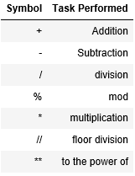
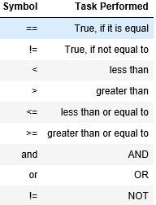
Arithmetic & Logical Operations Summary

Slide 6
Python Indexing – Format Function
Python Indexing always starts from
ZERO
Format( X1, X2, X3, X4, X5)
0 | 1 | 2 | 3 | 4
For Example,
X1 = “Chiranjeev”
X2 = “Rohan”
X3 = 24
X4 = 27
X5 = “WNS”
print("{0} and {1} both are engaged with {4}. {1}'s age is {3} and {0}'s age is {2}".format(X1,X2,X3,X4,X5))

Slide 7
Lists
Data structures are a special way of storing and accessing data and play an important role in manipulations as well.
List Symbol : []
TIP:1: A list can contain any Python Data Type. Although it's not really common, a list can also contain a mix of Python types including strings, floats, Booleans, etc.
Area of different rooms of a house
>>> hall = 11.25
>>> bed = 10.75
>>> bath = 9.50
>>> areas = ["hallway", hall, "bedroom", bed, "bathroom", bath]
>>> areas
['hallway', 11.25, 'bedroom', 10.75, 'bathroom', 9.5]

Slide 8
Lists Summary
Subseting, Slicing and Dicing : list_1[0]
Adding elements of more than one lists into one list or joining multiple lists into one list
Simple Addition operation (+)
Extend function
Append function
Subtracting elements from one list to other
Set() function
Splitting single string to the list.
Split function
Slicing a single string element.
Example:
val = "2 apples“
no_of_apples = val[0]
print('Number of apples is', no_of_apples)

Slide 9
Tuples & Dictionaries
Tuples are data structures that are similar to lists in all aspects except in the way they are declared and how much they allow themselves to be modified.
()
Immutable Python Objects.
Tuple Brackets -
Not possible to change tuple elements
A dictionary is a collection of words along with their meanings or a simpler explanation. At a broader level, we could call it as the mapping of words with their synonyms or meanings.
Key : Value
{“Word1”: “Meaning1” , “Word2”: “Meaning2”}
{}

Slide 10
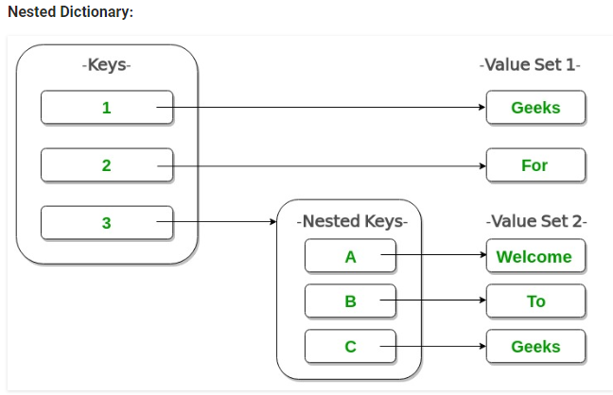
Nested Dictionary Example
Dictionary= {1: 'Geeks', 2: 'For', 3: {'A' : 'Welcome', 'B' : 'To', 'C' : 'Geeks'}}

Slide 11
Print(“Thank You”)

